Slide 1
Project BIO331
Pydamage Software
Yaniv kovalski
05/3/2021

Slide 2
Background
What tools are being used?
What concepts and terms are used?
Notes:
Workflow for assembly and variant calling including spades.
De novo concept to explain, the relevance to when a strand is new and nothing to refer to. Same way and fashion as the corona. That is done by the assemebly of small fragments.
Take out from the paper project a few points.

Slide 3
Protocol Pre Pydamage
Download software Pydamage (from github)
used library(rentrez) access list of ERRs from ENA database.
fastq-dumped the raw data
De novo assembled with metaspades
Aligned to one of the bacterial genomes they write about in the paper with bwa as in the variant calling workflow.
Convert to bam with samtools as in the variant calling workflow
Send the bam file to Pydamage
Quick start Pydamage (or use one of the API applications)
Analyze results.

Slide 4
Access ERR list from PREJB id number using rentrez library
fastq_d_function <- function(ERR_vector_input){
for(i in 1:length(ERR_vector_input)) { #next line for debuging cat("current SRR input is -",ERR_vector_input[i]) fastq_d_system <-paste("parallel-fastq-dump --sra-id", ERR_vector_input[i], "--threads 8 --outdir ./ --split-files --gzip",sep=" ") system(fastq_d_system) }}
fun<- function(){ xtrct_idNum_from_PRJNAinputRdLn <- paste(str_extract_all(readline("type in your PRJEB id number in here (i.e. PRJEB33577) "), "[0-9]", simplify = TRUE), collapse = "")
PRJEB_number <- paste("PRJEB",xtrct_idNum_from_PRJNAinputRdLn,sep="")
PRJEB_storage <- readline("type in directory name or desired path:\nExample 1: /projectnb2/ct-shbioinf/ykovalski/pyDamage_project/new_name_of_dir\nExample 2: new_name_of_dir")
system(paste("mkdir",PRJEB_storage,sep = " "))
setwd(PRJEB_storage)
input_system_PRJEB_id <- paste("esearch -db bioproject -query",PRJEB_number,"| efetch -format runinfo -mode xml | xtract -pattern ProjectID -element CenterID", sep = " ") id_insert <- system(input_system_PRJEB_id, intern = TRUE) get_ERR_files_names <- paste("esearch -db sra -query",id_insert,"| efetch -format runinfo -mode xml | xtract -pattern SraRunInfo -element Run", sep= " ") ERR_vector_preSplit <- system(get_ERR_files_names, intern = TRUE) ERR_vector_postSplit<- strsplit(ERR_vector_preSplit, '\t') fastq_d_function(ERR_vector_postSplit) }
fun()

Slide 5
De novo assembled with metaspades
First, I assigned a data folder which I cd into.
Then I made sure to load spades
Then I used the following code to gunzip the files I needed for the following stages: gunzip files_project_28/ERR{somenumber}.fastq.gz
Later I ran the following code to the fastqs I gunzippped: metaspades.py -t 8 -k 21,33,55,77 -1 files_project_28/ ERR{somenumber}_1.fastq -2 files_project_28/ ERR{somenumber}_2.fastq -o spades_output
Notes:
“The ZSM028 sample was first trimmed to remove adapters, low quality sequences with Q-scores below 125 20, and short sequences below 30 bp using AdapterRemoval (Schubert et al., 2016) v2.3.1. The reads 126 were de novo assembled into contigs using MetaSPAdes Nurk et al. (2017) v3.13.1 using the non-default 127 k-mer lengths 21, 33, and 45. Reads were then mapped back to the contigs with length > 1,000 bp 128 using Bowtie2 (Langmead and Salzberg, 2012), in the very-sensitive mode, while allowing up to 1 129 mismatch in the seeding process. The alignment files were then given as an input to PyDamage v0.50. 130 Contigs passing filtering thresholds were functionally annotated with Prokka v1.14.6 (Seemann, 2014), 131 using the --metagenome flag"
11:07
and before that: "We re-analyzed ancient metagenomic data from the archaeological paleofeces sample ZSM028 (Zape 28) 120 dating to ca. 1300 BP from the site of Cueva de los Muertos Chiquitos, in Mexico, previously published in 121 Borry et al. (2020) (ENA run accession codes ERR3678595, ERR3678598, ERR3678602, ERR3678603, 122 and ERR3678613)
“

Slide 6
Aligned a microbiome reference to Article’s archaeological Sample ZSM028
In the paper they chose three microbiome associated microbial taxa with low (Methanobrevibacter smithii, 31%), medium (Tannerella forsythia, 97 47%), and high (Actinomyces dentalis, 72%) GC content.
When I reproduced the paper’s methods I used the high GC content reference bacteria, the Actinomyces dentalis microbiome. Creating a bwa index and redid the variant calling workflow we completed in class.
Notes:
We chose three microbiome96 associated microbial taxa with low (Methanobrevibacter smithii, 31%), medium (Tannerella forsythia, 97 47%), and high (Actinomyces dentalis, 72%) GC
Aligned to one of the bacterial genomes they write about in the paper with bwa as in the variant calling workflow.

Slide 7
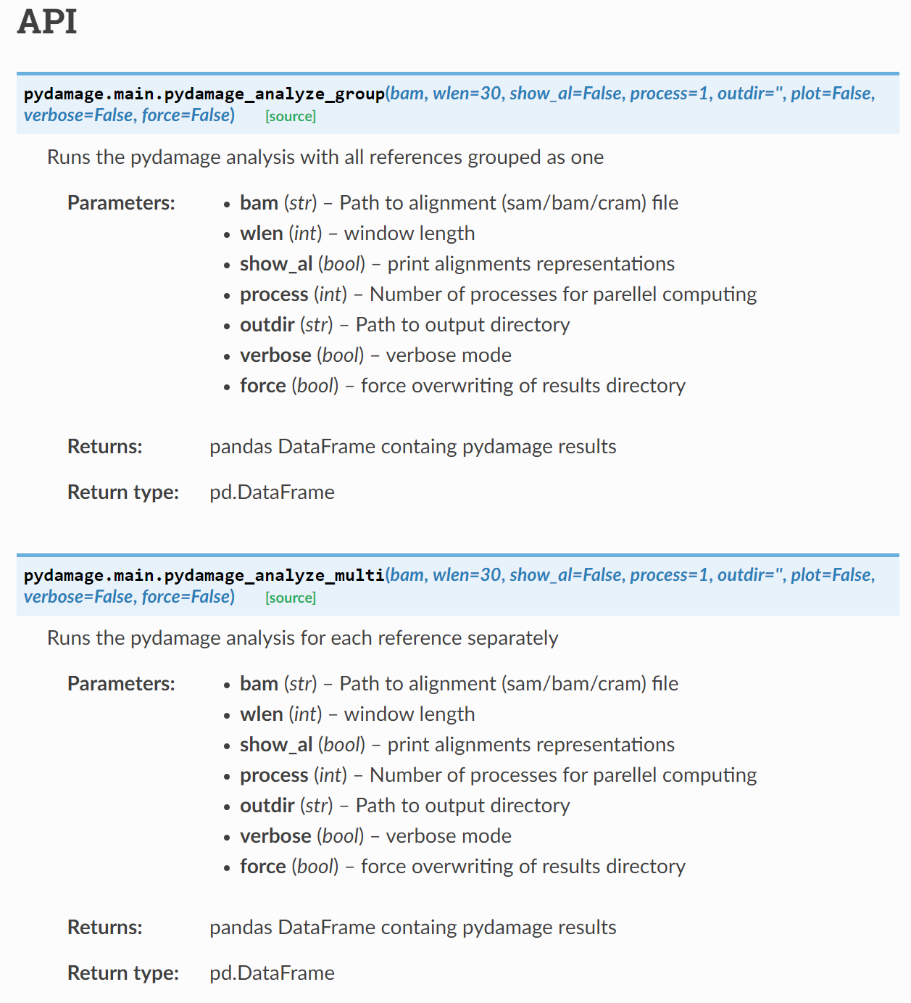
Construction of Bam file
Following to the last step, using the variant calling workflow, we converted using samtools into bam files.
Then the bam file was applied to the Pydamage software using Quick Start: pydamage analyze aligned.bam
Or as the right figure shows the further in depth application.
Notes:
Convert to bam with samtools as in the variant calling workflow
pydamage analyze aligned.bam

Slide 8
Results
https://pydamage.readthedocs.io/en/latest/output.html

Slide 9
References:
Class’ recordings
Paper PyDamage: automated ancient damage identification and estimation for contigs in ancient DNA de novo assembly
Maxime Borry, Alexander Hübner, A.B. Rohrlach, Christina Warinner
bioRxiv 2021.03.24.436838; doi: https://doi.org/10.1101/2021.03.24.436838
Code and Data availability:
• Genetic data for ZSM028 is available on the European Nucleotide Archive (ENA) under accession PRJEB33577.
• PyDamage Software and source code available from: github.com/maxibor/pydamage, license: GPLv3
• The code to replicate the simulation of reads and contigs, and the figures is available in the following citable GitHub repository: DOI: 10.5281/zenodo.4630383 - github.com/maxibor/pydamage-article

